Slide 1

Gate 0 Review: Guideline and Workbook
Go / No-Go
Digital NSW | DSSA
April 2026

Slide 2

Note
We are providing users with 3 main documents listed below to supplement the presentation, and it should be used by all parties during the review to ensure consistent and high-quality results throughout the process.
Guideline – Workbook
Term of Reference (TOR)
Report Template
Resources: https://www.digital.nsw.gov.au/policy/digital-assurance/resources-for-agencies-and-expert-reviewers
Gate 0 Review: Guideline and Workbook – Go / No-Go
2

Slide 3

The Digital Assurance Framework
Objectives of the DAF
To ensure NSW Government’s ICT projects are delivered on time and on budget through the implementation of a risk-based independent assurance framework.
To improve strategic alignment and assurance for ICT projects across the project lifecycle.
Gate 0 Review: Guideline and Workbook – Go / No-Go
3

Slide 4
Reviews under the DAF and confidentiality
Gateway reviews:
Are structured, expert peer reviews performed at critical points during the project lifecycle
Are not an audit
Provide a point in time snapshot of project performance, risks and issues
Help inform NSW Cabinet on delivery progress
Help Projects and Sponsors achieve their intended outcomes, on budget, on time
Are independent and confidential - interview discussions are not /should not be repeated
Encourage open and frank conversations - findings / discussions are not attributed to individuals, interviews with individuals (not groups)
Gate 0 Review: Guideline and Workbook – Go / No-Go
4

Slide 5
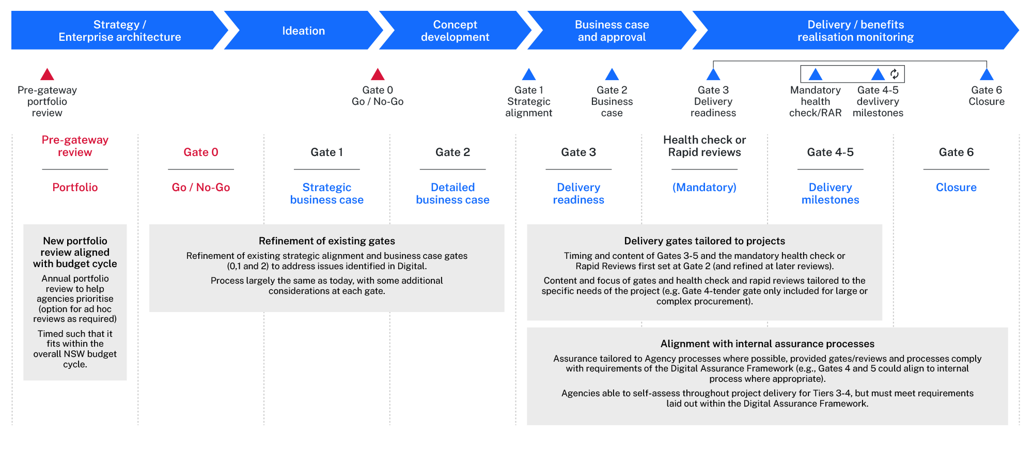
Overall DAF – Introducing Gate 0 and Pre-Gateway Review
Gate 0 Review: Guideline and Workbook – Go / No-Go
5

Slide 6
Gateway Review purpose
GATE 0: Go / No-Go
Stronger and expanded assessment to ensure projects that proceed are in line with Government’s priorities.
Application:
Agencies to register their project with Digital NSW earlier, to ensure all digital projects with a capital value over $10 million (and those nominated by DARAG) complete a Gate 0 Review before developing a strategic/detailed business case (SBC).
If a project has not completed a Gate 0 and seeks to complete a later Gateway Review, Digital NSW will require the agency to return to complete a Gate 0 Review
Assessment:
Broader set of focus questions to test which projects should proceed to an SBC. These align to; strategic risk, government priority, urgency of service need and other alternatives.
Expanded assessment process. Moving from a qualitative-only review to a combined quantitative and qualitative assessment to better justify a clear recommendation to Cabinet.
Consultation:
Agency right of replies on review outcome before Digital NSW submits them to Cabinet for a decision.
Gate 0 Review: Guideline and Workbook – Go / No-Go
6

Slide 7
Why do we do Gate 0?
Primary purpose:
Gate 0 exists to filter out projects which were never viable, are not aligned to government priorities or are not really needed now before money is spent on development activities.
Secondary benefits:
Helps projects start with clear objectives and service need.
Encourages agencies to consider alternative options or MVP first as an option.
Encourages agencies to undertake proper planning from which projects are generated (including prioritisation and consideration of options like better using state digital assets).
Provides agencies with guidance on issues that should be dealt with in the SBC.
What it is not:
A prioritisation exercise between projects (although the committee will consider whether proper prioritisation has occurred).
Approval or endorsement of a project.
A substitute for Gate 1 or Gate 2.
Gate 0 Review: Guideline and Workbook – Go / No-Go
7

Slide 8
Governance and Gate 0 cycle
Committee to make recommendations for GCIDO/DTB to consider and submit to Cabinet every quarter.
Aim is to provide certainty to agencies by resolving as quickly as possible.
Agency’s right of reply is to the Gate 0 Committee.
Gate 0 Committee
1 x Digital NSW (Assurance Chair)
1 x Treasury
1 x Cabinet Office
1 x Digital NSW (Strategy/EA)
2 x Independent Expert Reviewer
1 x nomination from DARAG
DARAG
Agency briefs due to Assurance
Gate 0 Committee Meeting
Deadline
for right
of reply
Included
in Cabinet
papers
ERC
(via Assurance CABSUB)
Same day as DARAG registration is due
2nd Wednesday of the month
3rd Wednesday of the month
Last week of the month
Gate 0 Review: Guideline and Workbook – Go / No-Go
8

Slide 9
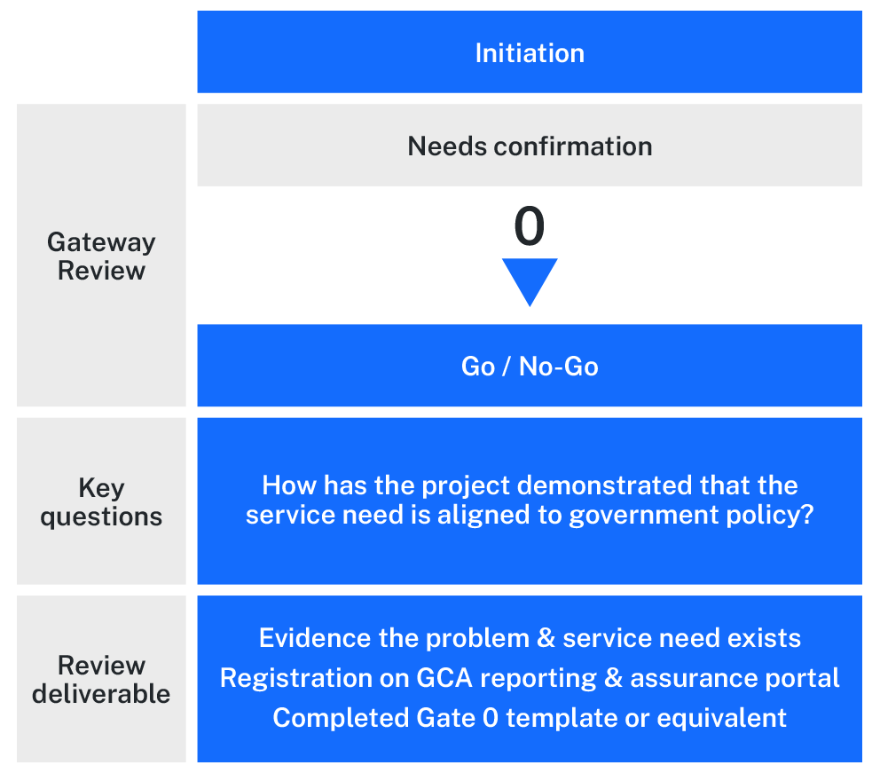
Overview and process
Mandatory documents needed
Registration Record of the project
Completed Gate 0 Project Justification template or equivalent Delivery Agency document
Relevant IT asset management framework or risk register and service planning document extract
Optional documents
Executive/Board level presentation on the project
Feasibility studies
Extracts from agency (Secretary/Chief Executive) approved plans and strategies
Agency specific project initiation documentation
Gate 0 Review: Guideline and Workbook – Go / No-Go
9

Slide 10
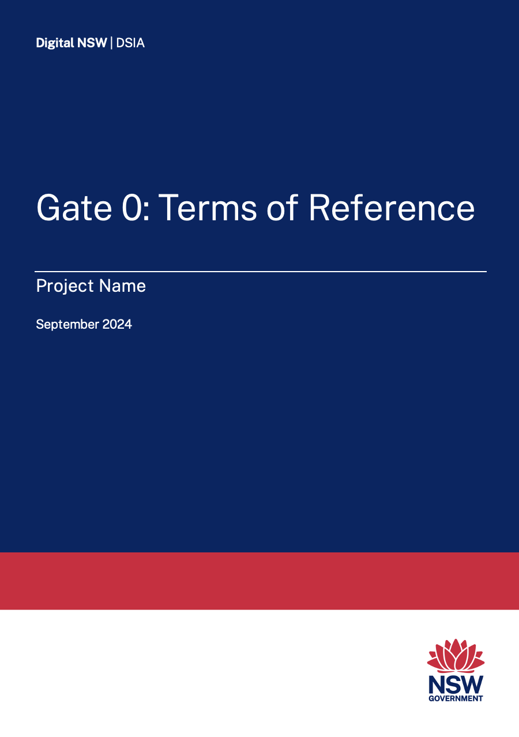
Areas of investigation
Set out in terms of reference and workbook
Government Priority
How has NSW Government identified the project / proposal as a strategic priority?
To what extent does the proposal support the government’s stated priorities?
Urgency
How urgent is the commencement of planning for the project? How critical are the consequences of delaying the commencement of planning?
Strategic Risk and Compliance Mitigation
How does the project / proposal mitigate agency’s strategic risks (i.e. implementation of critical security features such as MFA, Essential 8 etc.).
Alternatives
How has the project considered alternative solutions or funding sources?
Gate 0 Review: Guideline and Workbook – Go / No-Go
10

Slide 11
Potential recommendations
Set out in terms of reference and workbook
Proceed to next phase - the project is to continue to be developed in accordance with the appropriate processes, most commonly through the preparation of a Strategic Business Case;
Return to ERC with SBC – a strategic business case is to be developed in accordance with the appropriate processes, but the agency must return to ERC with the completed business case for advice on the strategic option to be further progressed;
Postpone further development of the project – the urgency of the project has not been demonstrated and further investment of resources is not required at this time; or
Cancel the project – the need for the project has not been demonstrated and resources should not be invested in a business case.
Gate 0 Review: Guideline and Workbook – Go / No-Go
11

Slide 12
What is the Gate 0 Committee looking for?
Question 1 – Government priority
The scope and timeframe of any election commitments and who made the commitment
Extent of criticality to any endorsed government priority, strategy or policy
Dependency of other approved projects or priorities on this project
Criticality to maintaining statutory compliance
If the project is to replace an asset at the end of its useful life, demonstration that the asset’s function is still needed by the government
Prioritisation against other similar projects
Gate 0 Review: Guideline and Workbook – Go / No-Go
12

Slide 13
What is the Gate 0 Committee looking for?
Question 2 – Urgency
Clear objectives and scope
Demonstrated urgency including any dependencies (eg stated government priority, public safety, capacity constraints, service gaps, commercial requirement, statutory obligation)
Evidence to support claimed urgency
For broad-based issues (eg impact of cybersecurity and privacy) demonstration that this project is relatively urgent compared to other actions that need to be taken
Expected timeframes for each stage of the project and how these align to the drivers of the urgency
Gate 0 Review: Guideline and Workbook – Go / No-Go
13

Slide 14
What is the Gate 0 Committee looking for?
Question 3 – Strategic risks
An extract from agency Enterprise Risks that demonstrates the need for the project
Clear evidence that the need has arisen from a systematic planning process and is not merely listed
Evidence of the process by which the agency has demonstrated a requirement to do the project to deliver on the agency’s strategic objectives
Demonstration of the prioritisation process which shows that this project will provide better value for money than other projects which are aligned to the agency’s strategic objectives
Gate 0 Review: Guideline and Workbook – Go / No-Go
14

Slide 15
Reasons why projects not been approved to proceed
“Cancel the project” or “postpone the project” recommendations
No evidence of prioritisation against other similar projects
Value for money not demonstrated
Commercial case and need for government to invest not demonstrated
Did not demonstrate need to replace existing facility
Objectives of the project were not clear
No clear minister sponsorship to support the project
“Return to Cabinet with SBC” recommendations
Election commitment was for a business case only
Solution was assumed and other strategic options might represent better value for money
Gate 0 Review: Guideline and Workbook – Go / No-Go
15

Slide 16
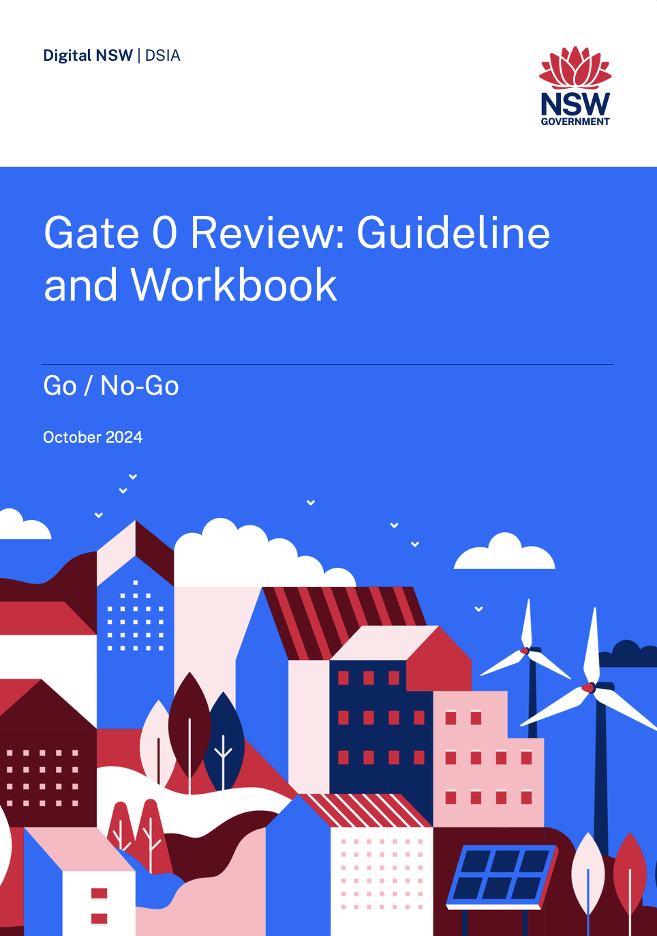
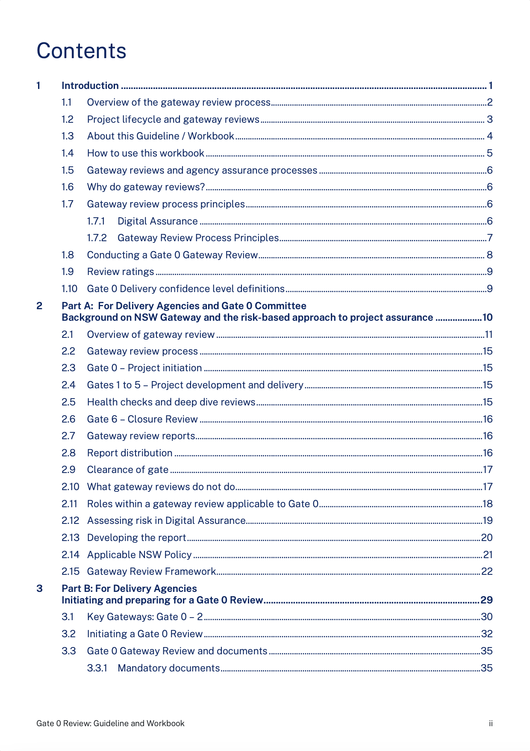
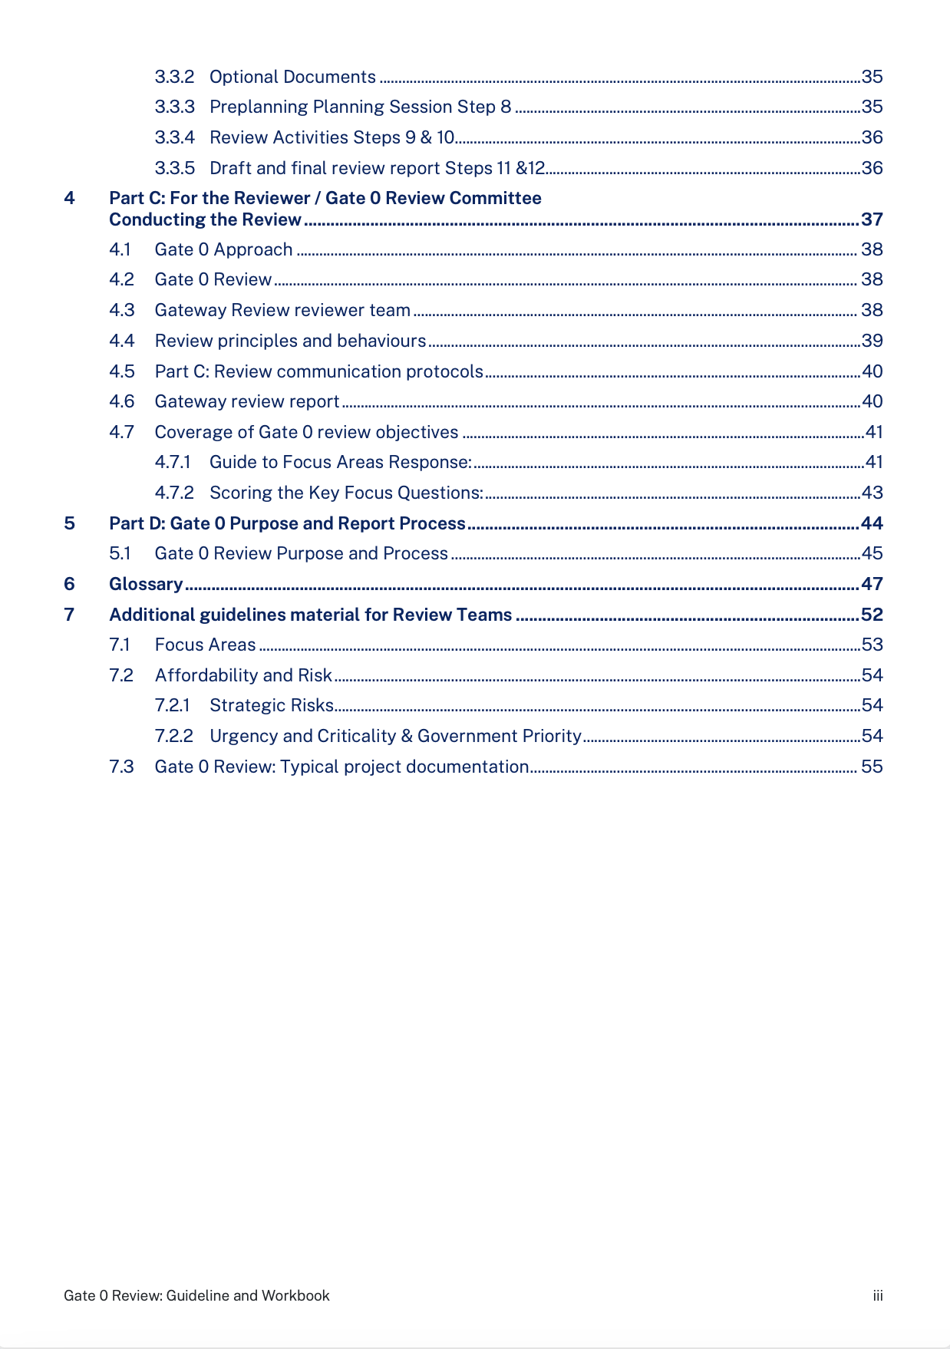

Gate 0 Workbook to be tested in pilot
Gate 0 Review: Guideline and Workbook – Go / No-Go
16

Slide 17
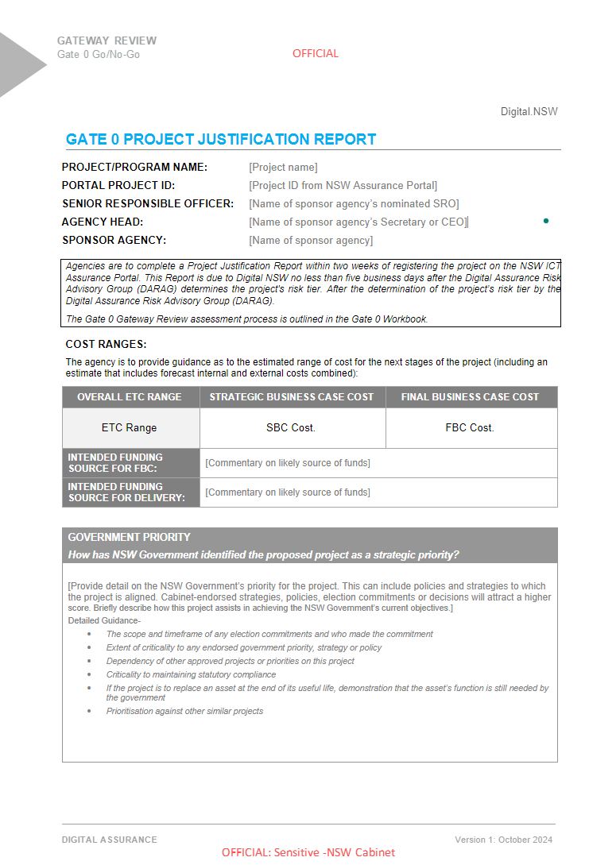
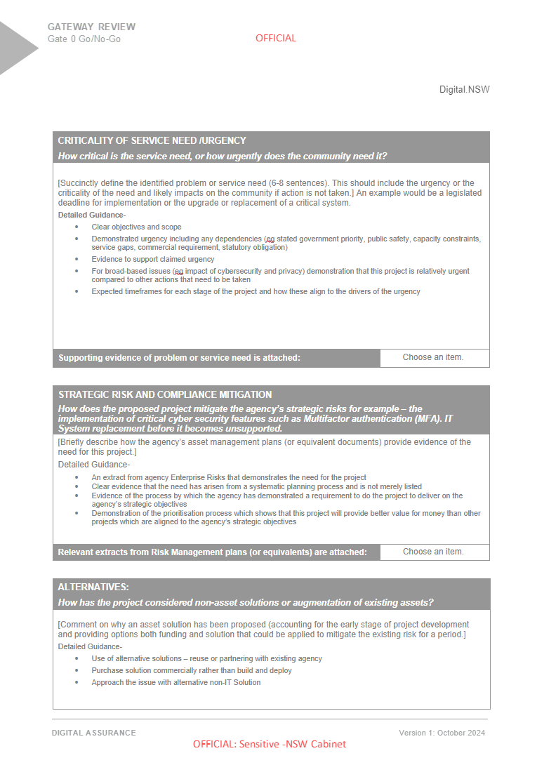
Report template – Project Justification pilot version
Gate 0 Review: Guideline and Workbook – Go / No-Go
17

Slide 18
Pilots to be run to test new format of Gate 0
2 Pilots have been identified to Pilot the new Gate 0 process.
1 More project is being sought to widen the field of projects to be assessed.
Gate 0 Review: Guideline and Workbook – Go / No-Go
18

Slide 19
More information
For more information please visit the Assurance Digital NSW website.
https://www.digital.nsw.gov.au/policy/digital-assurance/resources-for-agencies-and-expert-reviewers
Gate 0 Review: Guideline and Workbook – Go / No-Go
19

Slide 20
Appendix
Digital NSW | DSSA
Pre-Gate Self Assessment Tool
(not part of this Gate 0 Pilot)

Slide 21
Pre-Gate Self-Assessment Tool
As part of the implementation of the Gate 0 process a Pre-Gate self-assessment tool will be developed to help agencies quickly rule in or out their proposed process
Self-assessment will help capture all project in the pipeline and provide insights into the types of issues agencies are facing and why they want to develop a solution
The Self-assessment tool will be built to be as automated as possible with intelligent prompts
The data will also be linked to the Gate 0 assessment report and prepopulate all the of core material captured in the Self-Assessment tool saving time and effort
Once completed the agency will write up the Gate 0 draft in a similar way to the new Gate 6 process. A final review and independent assessment of the report will be conducted and then passed on to the DTB subcommittee for Gate 0 review
Agencies run the Pre-Gate Self-Assessment Tool and could also be feed into the DSSA prioritisation work
Gate 0 Review: Guideline and Workbook – Go / No-Go
21

Slide 22
Pre-Gateway Portfolio View (self-assessment)
Purpose of review
Develop a view of the future project portfolio
Provide guidance on how projects should be conceived and developed
Identify opportunities for collaboration and shared solutions
Changes from today to address issues:
Change from existing Gate 0 reviews
Review of portfolio of projects rather than individual projects
Refined to fit within the NSW budgeting process
Increased focus on collaboration opportunities and early guidance
Business and Digital perspective
Important input
Agency Corporate Plan
Asset Management Plans submitted to Treasury
Available and relevant project documentation
        Agency Digital project portfolio
        Need identification documents
        Indicative costing
        Project concept documents
        Investment Proposals (if relevant, including work in progress documents)
State Strategic Plans
Government and agency Digital Strategy and EA
Focus of review
Are business needs well understood?
Which projects may be high risk?
Have both business and Digital perspectives been considered?
Do projects / the portfolio align with NSW Digital strategy and EA?
Where are the key opportunities for collaboration in the future?
Where is there opportunity for re-use by the Agency?
Which projects may require extra thinking?
Required output
Summary of portfolio alignment with NSW Digital Strategy and EA
List of common priorities / needs across government for discussion at Strategic Planning workshops / other forums
Guidance for specific issues identified
List of potentially high priority / risk projects and scheduled Gate 1 reviews
Gate 0 Review: Guideline and Workbook – Go / No-Go
22

