Slide 1

Gate 1 Review: Guideline and Workbook
Strategic alignment
Digital NSW | DSSA
April 2026

Slide 2

Note
We are providing users with 3 main documents listed below to supplement the presentation, and it should be used by all parties during the review to ensure consistent and high-quality results throughout the process.
Guideline – Workbook
Term of Reference (TOR)
Report Template
https://www.digital.nsw.gov.au/policy/digital-assurance/resources-for-agencies-and-expert-reviewers
Gate 1 Review: Guideline and Workbook – Strategic alignment
2

Slide 3

The Digital Assurance Framework
Objectives of the DAF
To ensure NSW Government’s ICT projects are delivered on time and on budget through the implementation of a risk-based independent assurance framework.
To improve strategic alignment and assurance for ICT projects across the project lifecycle.
Gate 1 Review: Guideline and Workbook – Strategic alignment
3

Slide 4
Reviews under the DAF and confidentiality
Gateway reviews:
Are structured, expert peer reviews performed at critical points during the project lifecycle
Are not an audit
Provide a point in time snapshot of project performance, risks and issues
Help inform NSW Cabinet on delivery progress
Help Projects and Sponsors achieve their intended outcomes, on budget, on time
Are independent and confidential - interview discussions are not /should not be repeated
Encourage open and frank conversations - findings / discussions are not attributed to individuals, interviews with individuals (not groups)
Gate 1 Review: Guideline and Workbook – Strategic alignment
4

Slide 5
Gateway Review purpose
GATE 1: Strategic alignment
Ensures the business needs for the initiative are clearly defined and aligned with Strategic imperatives, Investment Principles and Enterprise Architecture.
Alignment to Government Enterprise Architecture
Policy and business context
Business case and stakeholders
Risk management
Readiness for next phase
Gate 1 Review: Guideline and Workbook – Strategic alignment
5

Slide 6

Gate 1 – ICT Assurance
Digital NSW | DSSA
Aims of Gate
Important input
Focus of review
Review outputs include
Stakeholder

Slide 7
Aims of Gate
1
2
3
Evidence of alignment with strategic direction of NSW Government and your Agency.
Evidence to support a robust process for selecting proposed project approach and ICT solution.
A forward-looking perspective of what is required to develop the business case.
Gate 1 Review: Guideline and Workbook – Strategic alignment
7

Slide 8
Important input
Portfolio alignment, common priorities and other output from pre-Gateway review.​
Investment proposal/preliminary ​business case.​
Preliminary financial and economic analysis.
Feasibility studies (for project and ​cross-agency impact).​
Project, risk, change, benefits realisation and stakeholder management plans.​
Plan for business case development (including resources required).
Gate 1 Review: Guideline and Workbook – Strategic alignment
8

Slide 9
Focus of review
Is there clear proof of alignment with the ICT Strategic Imperatives, Investment Principles?
Was the process for selecting the solution robust? Have previous projects / reviews (lessons learned) been considered?​
Is work needed for the business case understood (and resources/skills to ​
achieve this)?
Is the project modular, with modules no longer than 2 years (delivering benefits within that time)? ​
Are there plans for benefits realisation, stakeholder engagement, change management, risks and issues management, implementation strategy, governance, procurement, and transition.
Gate 1 Review: Guideline and Workbook – Strategic alignment
9

Slide 10
Review outputs include
End-of-day Sponsor update
Sponsor Debrief (coinciding with issue of Draft Report)
The Final Report covering:
        Review Team’s delivery confidence assessment rating
        i.e. High / Medium-High / Medium / Medium-Low / Low
        Detailed Recommendation explanation and classification
        i.e. Critical / Essential / Recommended
        Sponsor’s acknowledgement & comments
        Agency’s Recommendation responses / close out plan
        Agreement on next Review timing
Gate 1 Review: Guideline and Workbook – Strategic alignment
10

Slide 11
Stakeholder
Agency | DCS Assurance | Review panel
Submit relevant project material for review (via DCS Assurance)​ Continue project delivery as appropriate​ Develop action plan to address any recommendations from review and submit to DCS Assurance prior to Gate clearance​ | Establish review panel with input on members from agency​ Seek additional input as required​ Ensure review output is delivered to agency​ Confirm timing and content for further reviews (based on review)​ Inform ISSI of review outcomes by exception | Conduct review against previously agreed criteria (review documentation, interview stakeholders and draft report)​ Deliver results to DCS Assurance with recommendations
Gate 1 Review: Guideline and Workbook – Strategic alignment
11

Slide 12
Digital NSW | DSSA
Conducting a Gate 1 Gateway Review

Slide 13

Conducting a Gate 1 Gateway Review
Step | Activity
1 | Entry Criteria Prior to the Gate 1 or 2 the project must be registered in the ICT portal– DSSA, this is a prerequisite for initiating a Gate 1 review. ( It should be undertaken at least 6 weeks before initiating a Gate 1 ). 6 weeks prior to the Gateway commencement date, the Accountable Agency checks readiness of the project for the Gate 1 Review and contacts the Gateway Coordination Agency (GCA). (Note the DCS Assurance team will also monitor the likely timeframe through the regular assurance catch ups each month.) | 6 Weeks + prior
2 | GCA Review Manager (Digital Assurance) and Accountable Agency confirm the Review Dates. (Dates must consider key stakeholder availability including the Sponsor)
3 | GCA Review Manager appoints an independent Reviewer Team to the review. (As per the expert reviewer panel appointment process.)
Gate 1 Review: Guideline and Workbook – Strategic alignment
13

Slide 14

Conducting a Gate 1 Gateway Review
Step | Activity
4 | GCA Review Manager conducts a briefing with the Accountable Agency to gain a common understanding of the project’s status, identify any supporting documentation required and provide guidance on how to complete the Gate 1 readiness checklist template. | 1 Month prior Preparation / Planning TOR
5 | The Accountable Agency complete the Gate 1 readiness checklist template with input from key Agency stakeholders. A draft Terms of Reference (ToR) is also completed at this time by the GCA Review Manager (Digital Assurance), this is shared with the Agency to refine. The project sponsor to agree/sign off.)
Gate 1 Review: Guideline and Workbook – Strategic alignment
14

Slide 15

Conducting a Gate 1 Gateway Review
Step | Activity
6 | The Accountable Agency provide the Reviewer Team with the readiness checklist and provide supporting documentation to the allocated secure shared drive location. | Finalise Plan and Conduct
7 | Pre-Planning GCA Review Manager meets with the Independent Review Team to jointly review the Terms of Reference for the Gate 1 and if additional documentation is considered then the request can be made for this as well the key interviewees.
8 | Planning formal Kick off This starts with the kick-off meeting where the sponsor and delegates outline the project to be assessed and any key background needed to provide context. High level run through of the Gateway process, roles and responsibilities. Documentation requirements are confirmed, and interview are scheduled and confirmed.
Gate 1 Review: Guideline and Workbook – Strategic alignment
15

Slide 16

Conducting a Gate 1 Gateway Review
Step | Activity
9 | Review Week Entry criteria TOR Approved, All documentation is loaded and available to the team, All interviews are scheduled and confirmed, MS Teams Channel for Review teams set up and tested. Interview week commences and the scheduled interviews are undertaken by the Gateways reviewers. Up to 18 interviews could be held over this time with the Independent Review team The Review team complete the interviews and maintain feedback to the sponsor daily or as deemed appropriate. | Review Week
Gate 1 Review: Guideline and Workbook – Strategic alignment
16

Slide 17

Conducting a Gate 1 Gateway Review
Step | Activity
10 | The draft findings are prepared using the Gate 1 reporting Template. Noting the Scope items need to all be addressed including core areas of focus. The draft report is shared with Digital Assurance for initial QA Sponsors debrief is undertaken to outline the findings – this is a confidential meeting directly with sponsor. Report circulated to the Agency for fact check post Sponsor Debrief. Attention is to be given to Cyber, Privacy and now AI impact on the plan. | Reporting
11 | Post Review survey sent out to Accountable Agency, Reviewer Team and GCA Review Manager.
Gate 1 Review: Guideline and Workbook – Strategic alignment
17

Slide 18

Conducting a Gate 1 Gateway Review
Step | Activity
12 | Close-out Plan issued and managed by DCS ICT Digital Investment and Assurance (IDIA) Unit. | Post Review Within 4 weeks of report issue Post Review Activities
13 | Post Review Activities Record Critical and Essential issues for ongoing assurance follow up – note the Agency will need to provide adequate evidence of item closure. Critical rated items need to be closed before the clearance letter can be issued. This clearance can impact approval of funding. Charge back to be completed and reviewer invoice payment completed.
Gate 1 Review: Guideline and Workbook – Strategic alignment
18

Slide 19
Digital NSW | DSSA
Review
communications protocols

Slide 20
Review communications protocol
Topic | Details
Report Confidentiality | Review Reports are primarily for the consideration and noting of the NSW Cabinet to assist them in making key decisions about the project or to take action as required. All Review Reports are marked “OFFICIAL: Sensitive - NSW Cabinet” and are submitted to Cabinet. All participants must keep all information, including documentation, confidential at all times. Review Team Members must not directly contact the agency or stakeholders without the permission of the GCA Review Manager.
Report Distribution | The Reviewer Team must not distribute copies of any versions of Review Reports directly to agencies, project teams or any other party. The Reviewer Team sends the final draft of the Review Report to the GCA for review and distribution. There is no ‘informal’ element to a Gateway Review or the Review Report, and action will be taken if a Review Report is distributed without permission of the GCA. The Reviewer Team may not keep any copies of any version of the Review Report, or supporting documents, following submission to the GCA.
Gate 1 Review: Guideline and Workbook – Strategic alignment
20

Slide 21
Review communications protocol
Topic | Details
Review Debrief | The GCA Review Manager and the Reviewer Team will agree on the process and timing to conduct a Review debrief with the Accountable Agency following the development of the Review Report. The GCA Review Manager will approve the agency representatives that attend the debrief and may attend the debrief. There is no ‘informal’ element to Gateway Reviews. A debrief to the SRO or any agency executive must not occur without the approval of the GCA representative.
Report Format | All Review Reports must include a document control table. All Review Reports must include a list of people interviewed by the Lead Reviewer. All versions of reports issued by the Reviewer Team to the GCA are to be in MS WORD format. The final Review Report issued to the Accountable Agency SRO is to be watermarked as ‘FINAL’ and issued in PDF.
Report Transmittal | The GCA is required to keep a record of all parties, noting the Review Report version, and to whom the reports are issued. Reviewers should minimise the use of hard copies of Accountable Agency documents and must not keep documents in any form following the Review.
Gate 1 Review: Guideline and Workbook – Strategic alignment
21

Slide 22
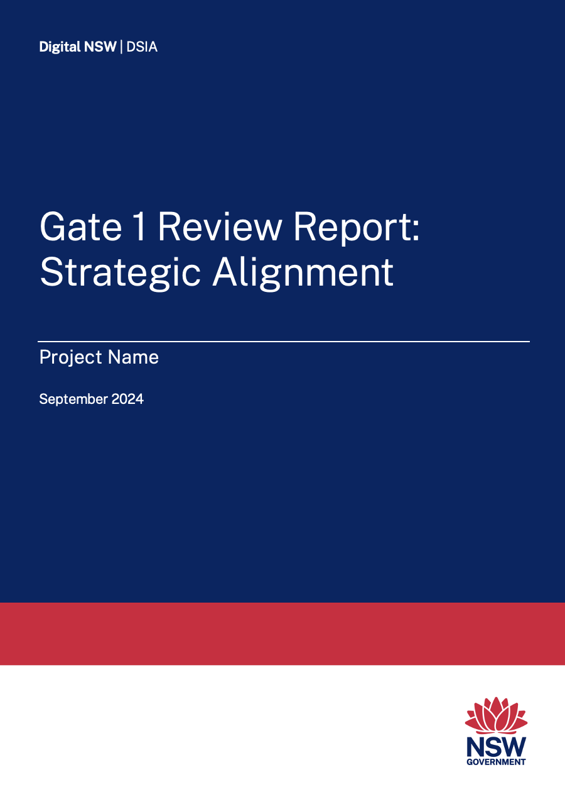
Gateway Review Report
The primary output of a Gateway Review is a high-quality written report that is candid and clear, absent of errors and without contradiction and inconsistencies.
The primary purpose of the Review Report is to inform the NSW Cabinet of project status and issues, with recommendations so appropriate action can be taken.
The Review Team should utilise the appropriate Review Report template incorporating the Gateway Review Ratings and the Review Recommendations Table.
The Gate 1 Report should be succinct and between 10 and 15 pages.
Gate 1 Review: Guideline and Workbook – Strategic alignment
22

Slide 23
Agency support
Project documentation – upload to Share
Planning meeting room and conference call set up point
Planning meeting invitation
Planning meeting project presentation
Interview schedule/register
(prefer 1 person per interview)
Document register – SharePoint
Interview room:
        Internet access
        Report writing room with screen
Interview invitations
Building access for panel
Additional documentation and interview requests from the review team panel
All review expenses
Gate 1 Review: Guideline and Workbook – Strategic alignment
23

