Slide 1

Gate 5 Review: Guideline and Workbook
Pre-commissioning
Digital NSW | DSSA
April 2026

Slide 2

Note
We are providing users with 3 main documents listed below to supplement the presentation, and it should be used by all parties during the review to ensure consistent and high-quality results throughout the process.
Guideline – Workbook
Term of Reference (TOR)
Report Template
https://www.digital.nsw.gov.au/policy/digital-assurance/resources-for-agencies-and-expert-reviewers
Gate 5 Review: Guideline and Workbook – Pre-commissioning
2

Slide 3

The Digital Assurance Framework
Objectives of the DAF
To ensure NSW Government’s ICT projects are delivered on time and on budget through the implementation of a risk-based independent assurance framework.
To improve strategic alignment and assurance for ICT projects across the project lifecycle.
Gate 5 Review: Guideline and Workbook – Pre-commissioning
3

Slide 4
Reviews under the DAF and confidentiality
Gateway reviews:
Are structured, expert peer reviews performed at critical points during the project lifecycle
Are not an audit
Provide a point in time snapshot of project performance, risks and issues
Help inform NSW Cabinet on delivery progress
Help Projects and Sponsors achieve their intended outcomes, on budget, on time
Are independent and confidential - interview discussions are not /should not be repeated
Encourage open and frank conversations - findings / discussions are not attributed to individuals, interviews with individuals (not groups)
Gate 5 Review: Guideline and Workbook – Pre-commissioning
4

Slide 5
Gateway Review purpose
GATE 5: Pre-commissioning
Assesses whether the organisation is ready to adopt the solution to achieve the planned benefits stated in the business case and implement the change management required.
Clearly defined sustainability of funding to deliver the system into the future in BAU including AI Monitoring, Cyber and Privacy checks
Business case and stakeholders
Risk management
Review of current phase
Readiness for next phase
Cyber, privacy and AI compliance sign offs should be completed and the ongoing plan into operations clearly specified.
Potential for multiple or recurrent health checks and milestone reviews.
Test leading indicators of problems to catch risks and issues early.
Ensure appropriate measures and checks are in place for ongoing assurance.
Gate 5 Review: Guideline and Workbook – Pre-commissioning
5

Slide 6

Gate 5 – ICT Assurance
Digital NSW | DSSA
Aims of Gate
Important input
Focus of review
Review outputs include

Slide 7
Aims of Gate
1
2
3
Assess readiness to Go-Live
Confirm plans in place to manage Risk and Change
Determine likelihood of original projected business benefit being achieved
Gate 5 Review: Guideline and Workbook – Pre-commissioning
7

Slide 8
Important documentation
Updated Business Case​
Recent Project Status Reports​
Steering Committee minutes​
Contract Documents​
Change Management Plan​
Project Management Plan​
Governance Arrangements​
Test Plan & Test Reports
Risks & Issues Register​
Risk Management Plan​
Implementation / Roll-back Contingency Plan​
Previous Gateway Review Reports and record of actions​
Training & Communication Plans​
Project Financials​
Benefits Management Plan
Gate 5 Review: Guideline and Workbook – Pre-commissioning
8

Slide 9
Focus of review
Is the project under control? Is it running according to plan / budget?​
Have all stakeholder issues been addressed? ​
Completeness of plans to go live? Is there a contingent plan to roll back / delay implementation? ​
Is the Agency ready to operationally manage the new service?
Is ownership after handover clearly understood? Has a RACI been established for the new Product / Service?​
Is the Agency ready to adopt new ways of working (if applicable)?​
Is there a process to manage and measure benefits ongoing? Is responsibility for this clear?​
Are end users adequately prepared for the transition?
Gate 5 Review: Guideline and Workbook – Pre-commissioning
9

Slide 10
Review outputs include
End-of-day Sponsor update
Sponsor Debrief (coinciding with issue of Draft Report)
The Final Report covering:
        Review Team’s delivery confidence assessment rating
        i.e. High / Medium-High / Medium / Medium-Low / Low
        Detailed Recommendation explanation and classification
        i.e. Critical / Essential / Recommended
        Sponsor’s acknowledgement & comments
        Agency’s Recommendation responses / close out plan
        Agreement on next Review timing
Gate 5 Review: Guideline and Workbook – Pre-commissioning
10

Slide 11
Digital NSW | DSSA
Conducting a Gate 5 Gateway Review

Slide 12

Conducting a Gate 5 Gateway Review
Step | Activity
1 | Entry Criteria Project has cleared previous critical issues raised in gateway, the project can demonstrate it is ready for commissioning in the near future. 6 weeks prior to the Gateway commencement date, the Accountable Agency checks readiness of the project for the Gate 5 Review and contacts the Gateway Coordination Agency (GCA). (Note the DCS Assurance team will also monitor the likely timeframe through the regular assurance catch ups each month.) | 6 Weeks + prior
2 | GCA Review Manager (Digital Assurance) and Accountable Agency confirm the Review Dates. (Dates must consider key stakeholder availability including the Sponsor)
3 | GCA Review Manager appoints an independent Reviewer Team to the review. ( As per the expert reviewer panel appointment process.)
Gate 5 Review: Guideline and Workbook – Pre-commissioning
12

Slide 13

Conducting a Gate 5 Gateway Review
Step | Activity
4 | GCA Review Manager conducts a briefing with the Accountable Agency to gain a common understanding of the project’s status, identify any supporting documentation required and provide guidance on how to complete the Gate 5 readiness checklist template. | 1 Month prior Preparation / Planning TOR
5 | The Accountable Agency complete the Gate 5 readiness checklist template with input from key Agency stakeholders. A draft Terms of Reference (ToR) is also completed at this time by the GCA Review Manager (Digital Assurance), this is shared with the Agency to refine. The project sponsor to agree/sign off.)
Gate 5 Review: Guideline and Workbook – Pre-commissioning
13

Slide 14

Conducting a Gate 5 Gateway Review
Step | Activity
6 | The Accountable Agency provide the Reviewer Team with the readiness checklist and provide supporting documentation to the allocated secure shared drive location. | Finalise Plan and Conduct
7 | Pre-Planning GCA Review Manager meets with the Independent Review Team to jointly review the Terms of Reference for the Gate 5 and if additional documentation is considered then the request can be made for this as well the key interviewees.
8 | Planning formal Kick off This starts with the kick-off meeting where the sponsor and delegates outline the project to be assessed and any key background needed to provide context. High level run through of the Gateway process, roles and responsibilities Documentation requirements are confirmed, and interview are scheduled and confirmed
Gate 5 Review: Guideline and Workbook – Pre-commissioning
14

Slide 15

Conducting a Gate 5 Gateway Review
Step | Activity
9 | Review Week Entry criteria TOR Approved, All documentation is loaded and available to the team, All interviews are scheduled and confirmed, MS Teams Channel for Review teams set up and tested. Interview week commences and the scheduled interviews are undertaken by the Gateways reviewers. Up to 18 interviews could be held over this time with the Independent Review team The Review team complete the interviews and maintain feedback to the sponsor daily or as deemed appropriate. | Review Week
Gate 5 Review: Guideline and Workbook – Pre-commissioning
15

Slide 16

Conducting a Gate 5 Gateway Review
Step | Activity
10 | The draft findings are prepared using the Gate 5 reporting Template. Noting the Scope items need to all be addressed including core areas of focus. The draft report is shared with Digital Assurance for initial QA Sponsors debrief is undertaken to outline the findings – this is a confidential meeting directly with sponsor. Report circulated to the Agency for fact check post Sponsor Debrief. Attention is to be given to Cyber, Privacy and now AI impact on the plan. | Reporting
11 | Post Review survey sent out to Accountable Agency, Reviewer Team and GCA Review Manager.
Gate 5 Review: Guideline and Workbook – Pre-commissioning
16

Slide 17

Conducting a Gate 5 Gateway Review
Step | Activity
12 | Close-out Plan issued and managed by DCS ICT Digital Investment and Assurance (IDIA) Unit | Post Review Within 4 weeks of report issue Post Review Activities
13 | Post Review Activities Record Critical and Essential issues for ongoing assurance follow up – note the Agency will need to provide adequate evidence of item closure. Critical rated items need to be closed before the clearance letter can be issued. This clearance can impact approval of funding. Charge back to be completed and reviewer invoice payment completed.
Gate 5 Review: Guideline and Workbook – Pre-commissioning
17

Slide 18
Digital NSW | DSSA
Review
communications protocols

Slide 19
Review communications protocol
Topic | Details
Report Confidentiality | Review Reports are primarily for the consideration and noting of the NSW Cabinet to assist them in making key decisions about the project or to take action as required. All Review Reports are marked “OFFICIAL: Sensitive - NSW Cabinet” and are submitted to Cabinet. All participants must keep all information, including documentation, confidential at all times. Review Team Members must not directly contact the agency or stakeholders without the permission of the GCA Review Manager.
Report Distribution | The Reviewer Team must not distribute copies of any versions of Review Reports directly to agencies, project teams or any other party. The Reviewer Team sends the final draft of the Review Report to the GCA for review and distribution. There is no ‘informal’ element to a Gateway Review or the Review Report, and action will be taken if a Review Report is distributed without permission of the GCA. The Reviewer Team may not keep any copies of any version of the Review Report, or supporting documents, following submission to the GCA.
Gate 5 Review: Guideline and Workbook – Pre-commissioning
19

Slide 20
Review communications protocol
Topic | Details
Review Debrief | The GCA Review Manager and the Reviewer Team will agree on the process and timing to conduct a Review debrief with the Accountable Agency following the development of the Review Report. The GCA Review Manager will approve the agency representatives that attend the debrief and may attend the debrief. There is no ‘informal’ element to Gateway Reviews. A debrief to the SRO or any agency executive must not occur without the approval of the GCA representative.
Report Format | All Review Reports must include a document control table. All Review Reports must include a list of people interviewed by the Lead Reviewer. All versions of reports issued by the Reviewer Team to the GCA are to be in MS WORD format. The final Review Report issued to the Accountable Agency SRO is to be watermarked as ‘FINAL’ and issued in PDF.
Report Transmittal | The GCA is required to keep a record of all parties, noting the Review Report version, and to whom the reports are issued. Reviewers should minimise the use of hard copies of Accountable Agency documents and must not keep documents in any form following the Review.
Gate 5 Review: Guideline and Workbook – Pre-commissioning
20

Slide 21
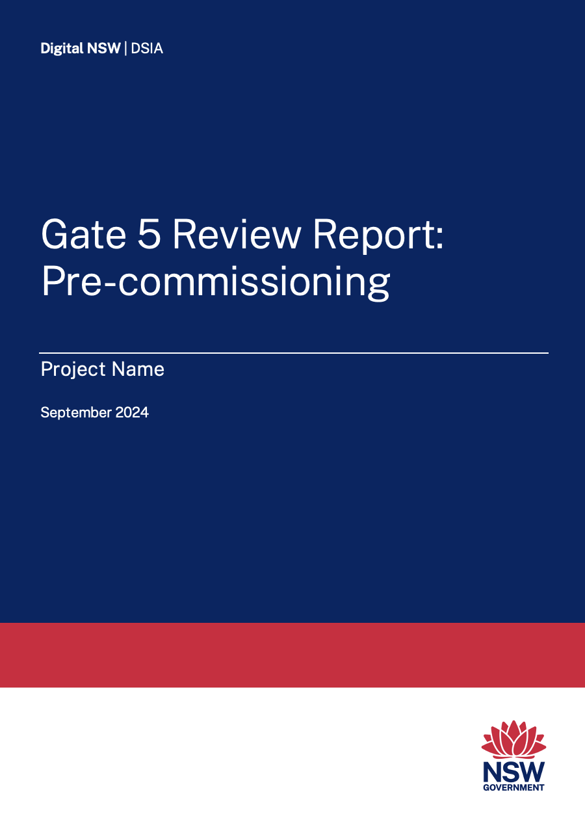
Gateway Review Report
The primary output of a Gateway Review is a high-quality written report that is candid and clear, absent of errors and without contradiction and inconsistencies.
The primary purpose of the Review Report is to inform the NSW Cabinet of project status and issues, with recommendations so appropriate action can be taken.
The Review Team should utilise the appropriate Review Report template incorporating the Gateway Review Ratings and the Review Recommendations Table.
The Gate 5 Report should be succinct and between 10 and 15 pages.
Gate 5 Review: Guideline and Workbook – Pre-commissioning
21

Slide 22
Agency support
Project documentation – upload to Share
Planning meeting room and conference call set up point
Planning meeting invitation
Planning meeting project presentation
Interview schedule/register
(prefer 1 person per interview)
Document register – SharePoint
Team support onsite or remote:
        Internet access
        Report writing room with screen
        MS Teams Channel for reviewers
Interview invitations
Building access for panel
Additional documentation and interview requests from the review team panel
All review expenses
Gate 5 Review: Guideline and Workbook – Pre-commissioning
22

