Slide 1
Gate 6 – Closure Report Guidelines
Department of Customer Service
Digital Strategy, Sourcing and Assurance (DSSA)
Notes:
Here’s a summary of the deck:
Main ideas:Gate 6 Update: Gate 6 is being rebuilt using the INSW workbook as a guide, with a new draft reporting template and workbook undergoing finalization
1Benefits Realisation: The Gate 6 Report supports the close-out of the delivery stage into operations and assesses the successful delivery of the purpose and benefits of the government’s investment in the project
2Gate 6 Process: The expert Lead Reviewer will work and collaborate with the agency to complete the Gate 6 Report and benefits realisation, with a streamlined process including documentation, alignment, template completion, and final report submission 3
4Confidence Rating: The Lead Reviewer will assign the project an overall confidence rating and also provide recommendations rating (critical, essential or suggested)

Slide 2
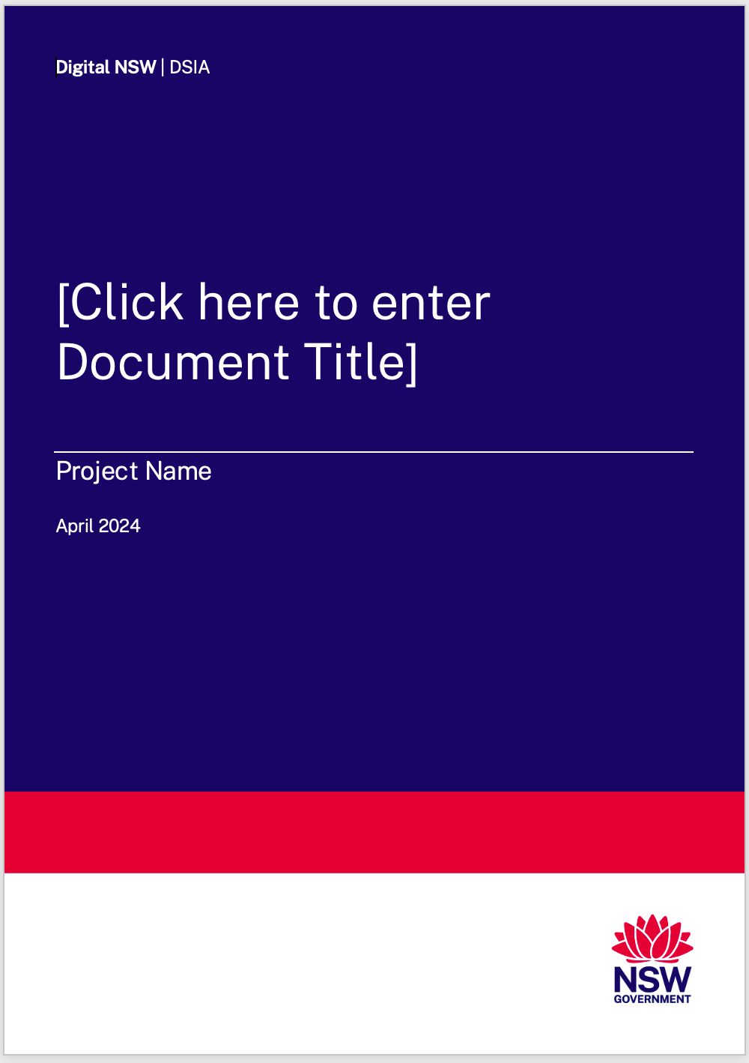
Agenda
Key Objectives of Closure review
Changes to Approach
Key Steps and approximate end to end timeline
Q&A
Conduct of Review
Report Preparation Structure and Format

Slide 3

Key objectives of the closure review
The final approved / approved re-baselined budget reconciles to the business case
The Sponsor is aware of any open issues that need to still be monitored or followed up
Benefits have been clearly identified and captured and a strategy and ownership is in place to continue to harvest these
Any lessons that can be learned from the project as a whole to be captured for the future
The work will be completed in a collaborative manner with the project team
7 Areas of focus will still be a guide to answering this question
Has the investment made by government achieved the original objectives stated in the original approved business case

Slide 4
Purpose of the Closure review
The purpose of the Gate 6 Closure Review is to support the close-out of the delivery stage into operations and to assess the successful delivery of the purpose and benefits of the government’s investment in the project. In addition, the review confirms that all relevant whole-of-government ICT policies, standards and priorities have been considered.
It is part of an overall Gateway Review Framework and measures progress and recommendations in terms of seven focus areas for ICT projects in NSW.

Slide 5

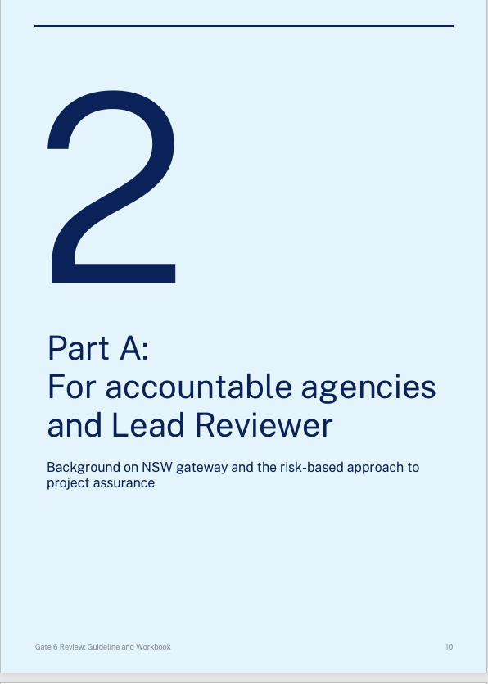
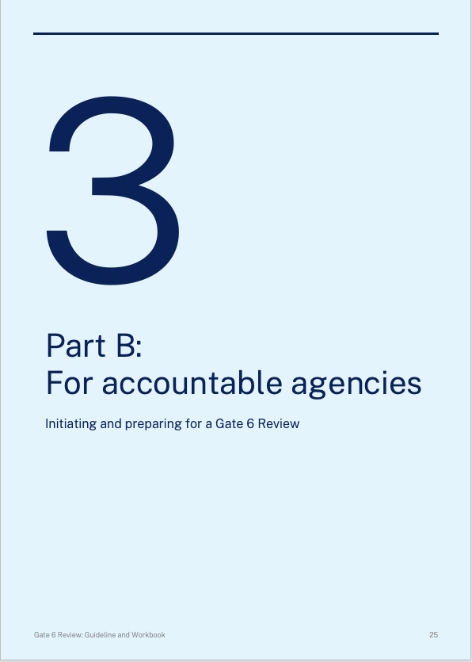
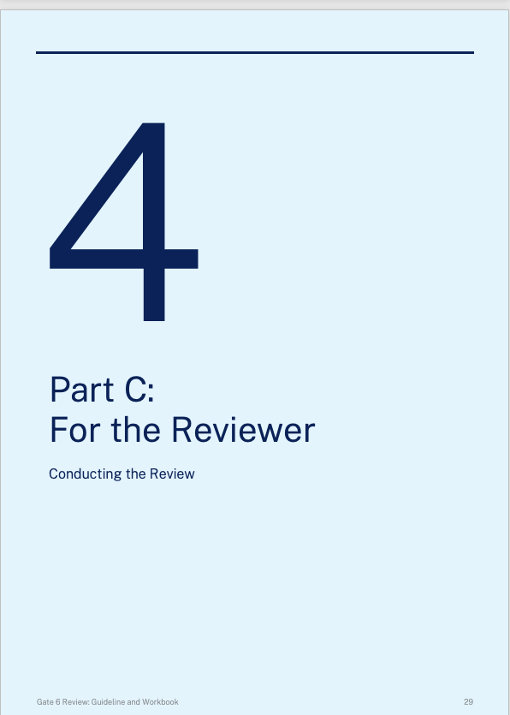
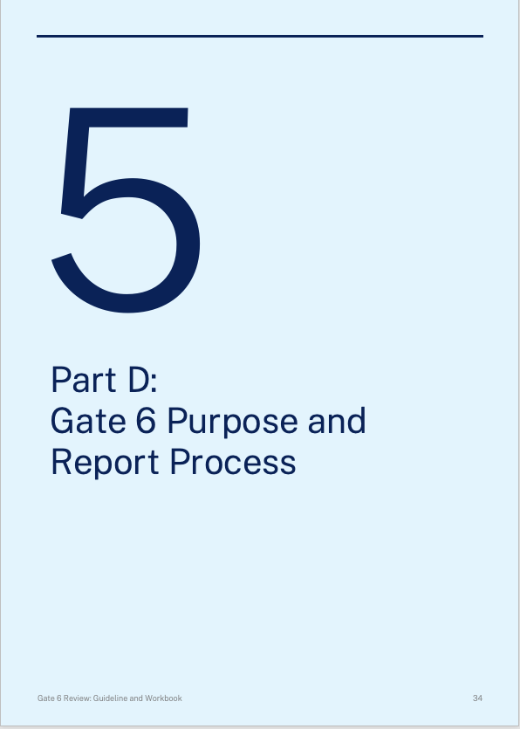
Guides for Each Stakeholder

Slide 6
Changes to Approach
The gateway review will take the best of the original Post-Implementation Review (PIR) and the current INSW Benefits Realisation gateway to form an enhanced review with clearer more achievable objectives as noted above
The approach will require a longer planning phase to help ensure the client is ready for the gateway review
The emphasis is on collaboration – working together with the project team to confirm the key closure activities have been completed
A focus on helping the sponsor understand that all material closure activities have been completed to a satisfactory level
Working with the project team to understand if there are issues that need to be monitored in BAU
The template will be partially completed by the project team to help speed up the process and avoid any mismatch of historical facts – reducing the time scale and scope of fact check

Slide 7
Gate 6 Overall Process The expert Reviewer Team will work and collaborate with the agency to complete the Gate 6 Report.
1. Documentation Ready
Agency to have all relevant project docs available for lead reviewer
3. Gate 6 Template
Expert reviewer to collaborate with agency to fill in report template
(up to 4 to 5 days)
4. Submit Final Draft
Lead Reviewer to submit Draft report for review/feedback/fact check to agency
5. Final Report and Confidence Rating
Review feedback and Submit Final report to Sponsor
6. Retros and recommendations
Feedback loop. Close out plan to track/action and respond the recommendations
2. Alignment Session
Briefing session to ensure alignment with both expert reviewers and the agency

Slide 8
Conduct of the review
Planning – Up to 3 months Prior to review
Giving a longer lead time allows the agency to make sure it has had the opportunity to prepare all the necessary documentation and to check
The reduces time lost in the review where documents are not ready and allows the Sponsor and PD to prepare before staff leave the project
The focus is on the project’s purpose, functionality, benefits, residual risks from delivery, transition to operation and lessons learnt. ( Approach to ongoing compliance with Cyber, AI and Privacy requirements as these present ongoing risks in BAU)
The Report content is to be initially jointly drafted by the project team and (project director and reviewed by the sponsor) delivery agency and asset owner/operator agency.
The drafting is led by the project director with oversight by the sponsor most appropriate agency and must be completed within three weeks of the Gate 6 project briefing conducted with Digital Assurance NSW and the Lead Reviewer.
Review Fieldwork & Reporting
Digital Assurance NSW will appoint a Lead Reviewer and a review team member, where appropriate, to assess the draft Report and oversee the completion of the Gate 6 Report, including the Report’s recommendations and rating.
Digital Assurance NSW and the Review team will participate in an alignment session (project briefing), which the agency will arrange along with any necessary further evidence (documentation), site tour or interviews required by the review team.
The review will be conducted with the project team working to refine the report and validate all the contents – not a stand back a interview process as other gates are currently run
Emphasis on answering the common questions on closure and identifying any issues that need to be addressed
While Recommendations can be suggested by the agency, it is the Reviewer Team that will determine both the final draft Report content, Review Rating, and final Recommendations.

Slide 9
Key steps and Approximate Timeline
Schedule | Date
Project documents, made available to Reviewers by agency this will include the draft Gate 6 report template completed by the project team – ( This is established and agreed 2 months prior to review)_ | 3 Weeks Before the Kick off
Planning Meeting (1-2 hours) review of the draft report and discuss logistics to complete the review | Two Weeks Before field work week
Report review and Interviews | Field Work Week
Publish Draft Report for Project team to complete final Fact Check | End of field work week
Project Team fact check the draft report and mark up comments | 1 Week post field work
The Reviewers review draft report fact check comments and prepare feedback for a meeting with Sponsor | 2 Days elapsed to review
Sponsor Debrief on Review Findings and Recommendations (1 hour) | TBD within 2 weeks of end field work
Publish Final Report

Slide 10
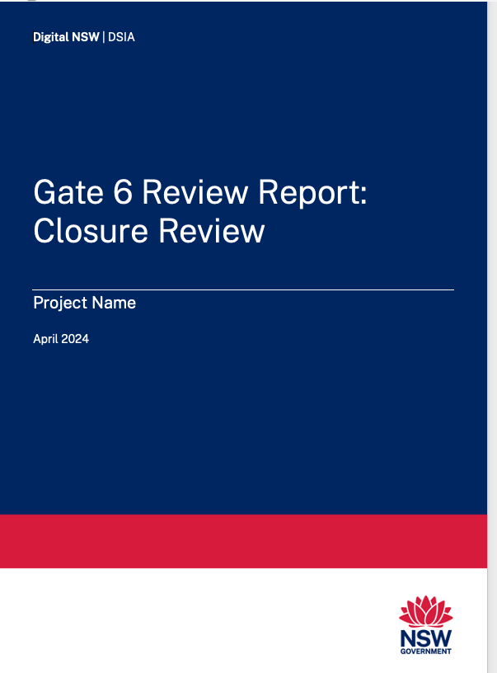
Report Structure and Format
The Gate 6 Report is in five parts:
Project Context – a summary of the delivery outcomes of the project to time, cost, scope and benefits
Project Handover – a summary of the status of the handover of the project from delivery into operations
Lessons Learnt – the agency’s reflection on actions taken that impacted outcomes (good & bad)
Recommendations – actions the agency could take to improve any existing issues or for the future.
Status of BAU risk compliance approach over AI, Cyber and Privacy

Slide 11
Overall Confidence Rating against the business case The Reviewer Team will assign the project an overall confidence rating and also provide recommendations rating (Critical, Essential or Recommended)
High | Project has successfully delivered against the business base, purpose, outcomes and benefits against its agreed objectives, to time, cost and quality. Lessons learned have been considered, and anticipated benefits are being delivered and/or on track to being delivered; and There are no outstanding issues that appear to threaten benefits realisation and/or plans for ongoing improvements in value, service enhancements and performance.
Medium-High | Project has delivered most outcomes against its agreed objectives, to time, cost and quality. • Lessons learned have been considered, and anticipated benefits are being delivered and/or on track to being delivered; and • There are no major outstanding issues that appear to threaten benefits realisation and/or plans for ongoing improvements in value, service enhancements and performance.
Medium | Project has delivered outcomes against its agreed objectives, to time, cost and quality; • Lessons learned have not been considered in their entirety, and/or there are risks that may threaten plans for ongoing improvements in value, service enhancements and performance; or • The benefit realisation plan of the anticipated benefits is not completed, the outstanding issues appear to be resolvable at this stage, if addressed promptly.
Medium-Low | Project has delivered most outcomes against its agreed objectives, to time, cost and quality; • Lessons learned have not been considered in their entirety, and/or there are major risks/issues that may threaten plans for ongoing improvements in value, service enhancements and performance; or • Major risks and/or issues exist that threaten the realisation of anticipated benefits which, at this stage, do not appear to be manageable or resolvable.
Low | Project has not delivered most of the outcomes against its agreed objectives, or had not delivered to time, cost and quality; • Lessons learned have not been considered in their entirety, and there are major risks/issues that threaten plans for ongoing improvements in value, service enhancements and performance; or • Major risks and/or issues exist that threaten the realisation of anticipated benefits which, at this stage, do not appear to be manageable or resolvable

Slide 12
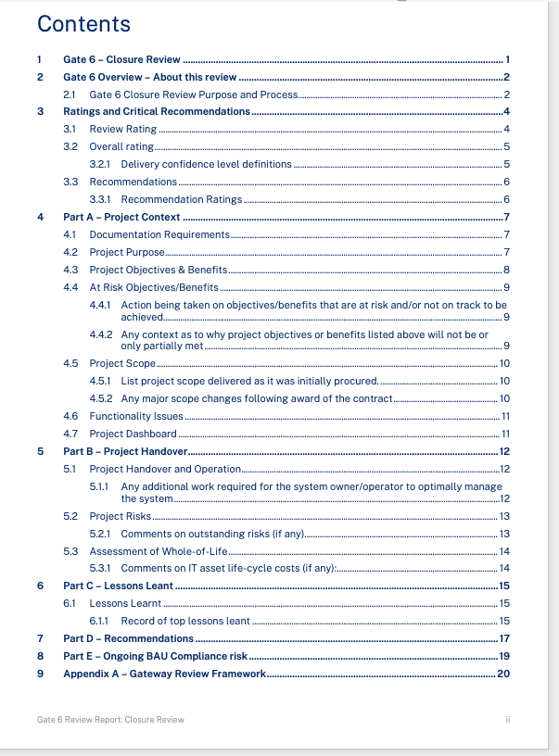
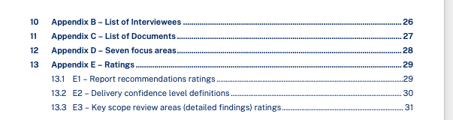
Report Outline
Executive Summary
Part A – Project Context
Part B Project Handover
Part C Lessons Learnt
Part D Recommendations
Part E – Ongoing BAU Compliance Risk

Slide 13
Conclusion
The Gate 6 Closure review will help provide a more relevant assessment of projects and will give the government a clearer view of investments made in ICT
The approach will aim to assess the relative maturity of agencies to undertake large scale ICT project and may help manage this risk into the future
Ongoing risks that are emerging with BAU systems and platforms can also be identified and tracked
Sponsors will have a clearer view of their status and obligations
Wider benefits can be gained from this exercise over time that will help support the wider implementation of state digital assets

