Slide 1

Health Check Review: Guideline and Workbook
Digital NSW | DSSA
April 2026

Slide 2


Acknowledgement of Country
Digital Strategy, Sourcing and Assurance (DSSA) acknowledges and respects the Traditional Custodians of the lands on which we live, walk and work.
We pay our respects to Elders past, present and future, and celebrate Aboriginal people's unique cultural and spiritual connection to lands, waters and seas.
Health Check Review: Guideline and Workbook
Notes:
I would like to start by acknowledging the traditional owners, the Darag people, on whose land we are meeting today.
I would also like to pay my respects to Elders past, present and emerging and welcome all Aboriginal people here with us today.

Slide 3

Note
We are providing users with 3 main documents listed below to supplement the presentation.
These documents should be used by all parties during the review to ensure consistent and high-quality results throughout the process.
Guideline – Workbook
Term of Reference (TOR)
Report Template
Website link: Digital Assurance | Digital NSW
Health Check Review: Guideline and Workbook
3

Slide 4

The Digital Assurance Framework
Objectives of the DAF
To ensure NSW Government’s ICT/digital projects are delivered on time and on budget through the implementation of a risk-based independent assurance framework.
To improve strategic alignment and assurance for ICT/digital projects across the project lifecycle.
Health Check Review: Guideline and Workbook
4

Slide 5
Reviews under the DAF and confidentiality
Gateway reviews:
Are structured, expert peer reviews performed at critical points during the project lifecycle
Are not an audit
Provide a point in time snapshot of project performance, risks and issues
Help inform NSW Cabinet on delivery progress
Help Projects and Sponsors achieve their intended outcomes, on budget, on time
Are independent and confidential - interview discussions are not /should not be repeated
Encourage open and frank conversations - findings / discussions are not attributed to individuals, interviews with individuals (not groups)
Health Check Review: Guideline and Workbook
5

Slide 6
Gateway Review purpose
Health Check
Test leading indicators of problems to catch risks and issues early
Ensure appropriate measures and checks in place for ongoing assurance
Demonstrated Alignment to Government priorities and relevant policies
Funding model to operate is sustainable for whole of life
Feasibility and options analysis are robust in meeting organisations needs and address government strategy
Assessment of delivery approach
Business case and stakeholders
Risk management
Review of current phase
Readiness for next phase
Assessment of Cyber, Privacy and AI compliance requirements, ensuring all implications are understood and addressed in the BC
Alignment to Government Enterprise Architecture
Identification of future multiple or recurrent health checks and milestone reviews.
Health Check Review: Guideline and Workbook
6

Slide 7

Health Check – Digital Assurance
Digital NSW | DSSA
Aims of Gate
Important input
Focus of review
Review outputs include

Slide 8
Aims of Health Check
1
2
3
4
Determine how the project is performing.
Support the review process with ‘point in time’ insights into areas of concern identified outside the Gates.
Identify issues affecting delivery to keep a project moving forward with fewer risks to successful implementation and check against specific project requirements at key delivery milestones.
Test leading indicators of problems to catch risks and issues early and ensure appropriate measures and checks are in place for ongoing assurance.
Health Check Review: Guideline and Workbook
8

Slide 9
Important input
Output from previous Gate
Relevant documentation determined and requested depending on previously identified needs of the project.
May include:
        Updated project management, risk, change, benefits realisation and stakeholder engagement plans and tracking
        Documented changes to scope, schedule and budget (including updated business case)
        Assessment of progress towards key and interim milestones
Health Check Review: Guideline and Workbook
9

Slide 10



Focus of review
Is there material departure from last Gate?
Have there been earlier issues or warning signs e.g. regularly changing project scope or delays?​
Have previous issues been addressed?​
How is project performing versus agreed measures?
Is project on track to deliver the agreed benefits and milestones?​
Is governance and project management effective?​
Is there significant risk / issues that may derail the project in the future (leading indicators)?​
Has there been relevant change to the (external) environment?
Health Check Review: Guideline and Workbook
10

Slide 11
Review outputs include
End-of-day Sponsor update
Sponsor Debrief (coinciding with issue of Draft Report)
The Final Report covering:
        Review Team’s delivery confidence assessment rating
        i.e. High / Medium-High / Medium / Medium-Low / Low
        Detailed Recommendation explanation and classification
        i.e. Critical / Essential / Recommended
        Sponsor’s acknowledgement & comments
        Agency’s Recommendation responses / close out plan
        Agreement on next Review timing
Health Check Review: Guideline and Workbook
11

Slide 12
Digital NSW | DSSA
Conducting a Health Check Review

Slide 13


Conducting a Health Check Review
Step | Activity
1 | Entry Criteria Prior to the review the project must be registered in the ICT portal– DSSA, this is a prerequisite for initiating a Health Check review. ( It should be undertaken at least 6 weeks before initiating a Gate 6 ). 6 weeks prior to the Gateway commencement date, the Accountable Agency checks readiness of the project for the Health Check Review and contacts the Gateway Coordination Agency (GCA). (Note the DCS Assurance team will also monitor the likely timeframe through the regular assurance catch ups each month.) | 6 Weeks + prior
2 | GCA Review Manager (Digital Assurance) and Accountable Agency confirm the Review Dates. (Dates must consider key stakeholder availability including the Sponsor)
3 | GCA Review Manager appoints an independent Reviewer Team to the review. (As per the expert reviewer panel appointment process.)
Health Check Review: Guideline and Workbook
13
Notes:
Step 1 – “( It should be undertaken at least 6 weeks before initiating a Gate 6 )” should this statement refer to gate 2?

Slide 14

Conducting a Health Check Review
Step | Activity
4 | GCA Review Manager conducts a briefing with the Accountable Agency to gain a common understanding of the project’s status, identify any supporting documentation required and provide guidance on how to complete the Health Check readiness checklist template. | 1 Month prior Preparation / Planning TOR
5 | The Accountable Agency complete the Health Check readiness checklist template with input from key Agency stakeholders. A draft Terms of Reference (ToR) is also completed at this time by the GCA Review Manager (Digital Assurance), this is shared with the Agency to refine. The project sponsor to agree/sign off.)
Health Check Review: Guideline and Workbook
14

Slide 15

Conducting a Health Check Review
Step | Activity
6 | The Accountable Agency provide the Reviewer Team with the readiness checklist and provide supporting documentation to the allocated secure shared drive location. | Finalise Plan and Conduct
7 | Pre-Planning GCA Review Manager meets with the Independent Review Team to jointly review the Terms of Reference for the Health Check and if additional documentation is considered then the request can be made for this as well the key interviewees.
8 | Planning formal Kick off This starts with the kick-off meeting where the sponsor and delegates outline the project to be assessed and any key background needed to provide context. High level run through of the Gateway process, roles and responsibilities. Documentation requirements are confirmed, and interview are scheduled and confirmed.
Health Check Review: Guideline and Workbook
15

Slide 16

Conducting a Health Check Review
Step | Activity
9 | Review Week Entry criteria TOR Approved, All documentation is loaded and available to the team, All interviews are scheduled and confirmed, MS Teams Channel for Review teams set up and tested. Interview week commences and the scheduled interviews are undertaken by the Gateways reviewers. Up to 18 interviews could be held over this time with the Independent Review team The Review team complete the interviews and maintain feedback to the sponsor daily or as deemed appropriate. | Review Week
Health Check Review: Guideline and Workbook
16

Slide 17

Conducting a Health Check Review
Step | Activity
10 | The draft findings are prepared using the Health Check reporting Template. Noting the Scope items need to all be addressed including core areas of focus. The draft report is shared with Digital Assurance for initial QA Sponsors debrief is undertaken to outline the findings – this is a confidential meeting directly with sponsor. Report circulated to the Agency for fact check post Sponsor Debrief. Attention is to be given to Cyber, Privacy and now AI impact on the plan. | Reporting
11 | Post Review survey sent out to Accountable Agency, Reviewer Team and GCA Review Manager.
Health Check Review: Guideline and Workbook
17

Slide 18

Conducting a Health Check Review
Step | Activity
12 | Close-out Plan issued and managed by DCS ICT Assurance. | Post Review Within 4 weeks of report issue Post Review Activities
13 | Post Review Activities Record Critical and Essential issues for ongoing assurance follow up – note the Agency will need to provide adequate evidence of item closure. Critical rated items need to be closed before the clearance letter can be issued. This clearance can impact approval of funding. Charge back to be completed and reviewer invoice payment completed.
Health Check Review: Guideline and Workbook
18

Slide 19
Digital NSW | DSSA
Review
communications protocols

Slide 20
Review communications protocol
Topic | Details
Report Confidentiality | Review Reports are primarily for the consideration and noting of the NSW Cabinet to assist them in making key decisions about the project or to take action as required. All Review Reports are marked “OFFICIAL: Sensitive - NSW Cabinet” and are submitted to Cabinet. All participants must keep all information, including documentation, confidential at all times. Review Team Members must not directly contact the agency or stakeholders without the permission of the GCA Review Manager.
Report Distribution | The Reviewer Team must not distribute copies of any versions of Review Reports directly to agencies, project teams or any other party. The Reviewer Team sends the final draft of the Review Report to the GCA for review and distribution. There is no ‘informal’ element to a Gateway Review or the Review Report, and action will be taken if a Review Report is distributed without permission of the GCA. The Reviewer Team may not keep any copies of any version of the Review Report, or supporting documents, following submission to the GCA.
Health Check Review: Guideline and Workbook
20

Slide 21
Review communications protocol
Topic | Details
Review Debrief | The GCA Review Manager and the Reviewer Team will agree on the process and timing to conduct a Review debrief with the Accountable Agency following the development of the Review Report. The GCA Review Manager will approve the agency representatives that attend the debrief and may attend the debrief. There is no ‘informal’ element to Gateway Reviews. A debrief to the SRO or any agency executive must not occur without the approval of the GCA representative.
Report Format | All Review Reports must include a document control table. All Review Reports must include a list of people interviewed by the Lead Reviewer. All versions of reports issued by the Reviewer Team to the GCA are to be in MS WORD format. The final Review Report issued to the Accountable Agency SRO is to be watermarked as ‘FINAL’ and issued in PDF.
Report Transmittal | The GCA is required to keep a record of all parties, noting the Review Report version, and to whom the reports are issued. Reviewers should minimise the use of hard copies of Accountable Agency documents and must not keep documents in any form following the Review.
Health Check Review: Guideline and Workbook
21

Slide 22
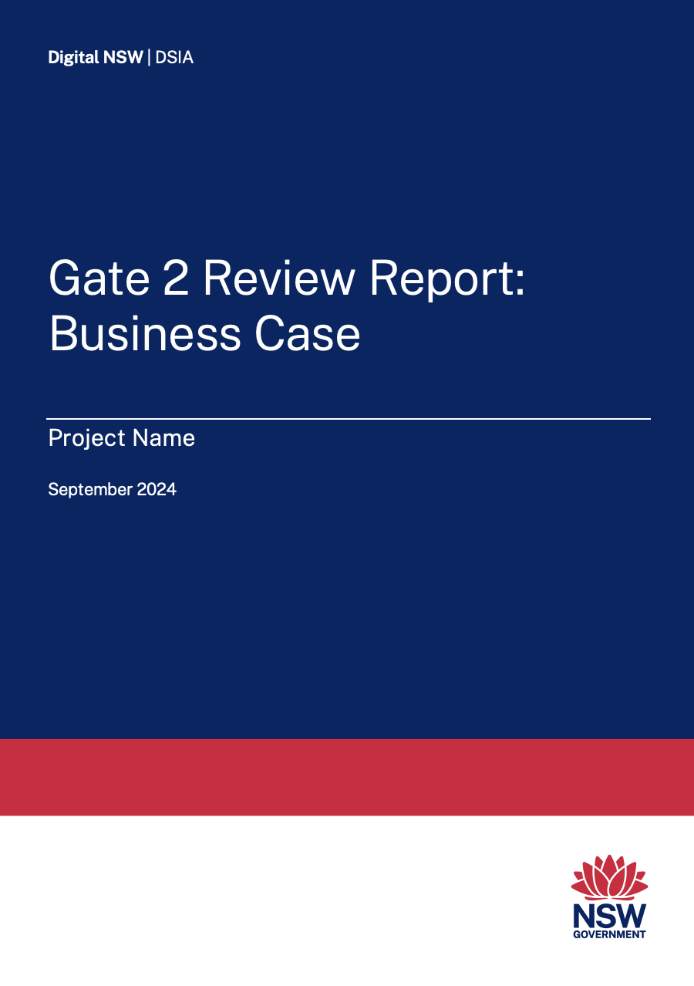
Gateway Review Report
The primary output of a Gateway Review is a high-quality written report that is candid and clear, absent of errors and without contradiction and inconsistencies.
The primary purpose of the Review Report is to inform the NSW Cabinet of project status and issues, with recommendations so appropriate action can be taken.
The Review Team should utilise the appropriate Review Report template incorporating the Gateway Review Ratings and the Review Recommendations Table.
The Health Check Report should be succinct and between 10 and 15 pages.
Health Check Review: Guideline and Workbook
22

Slide 23
Agency support
Project documentation – upload to Share
Planning meeting room and conference call set up point
Planning meeting invitation
Planning meeting project presentation
Interview schedule/register
(prefer 1 person per interview)
Document register – SharePoint
Interview room:
        Internet access
        Report writing room with screen
Interview invitations
Building access for panel
Additional documentation and interview requests from the review team panel
All review expenses
Health Check Review: Guideline and Workbook
23

